Slide 1
Additional Reg. Metrics

Slide 2
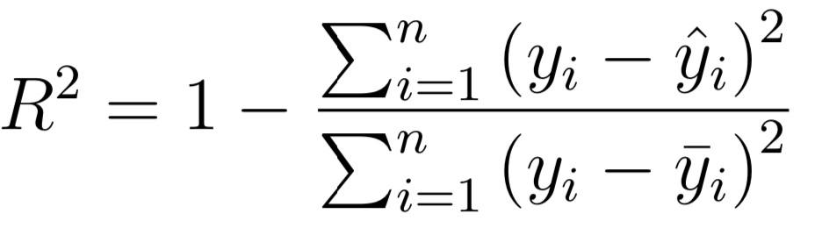
Additional Regression Metrics
Metrics
R2 score 1 -> -inf
Notes:
Photo: https://www.flickr.com/photos/107442568@N08/12547327134

Slide 3
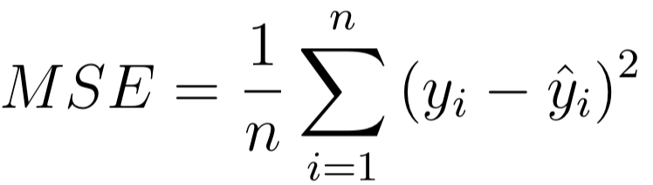
Additional Regression Metrics
Metrics
R2 score 1 -> -inf
Mean squared error 0 -> inf
Notes:
Photo: https://www.flickr.com/photos/107442568@N08/12547327134

Slide 4
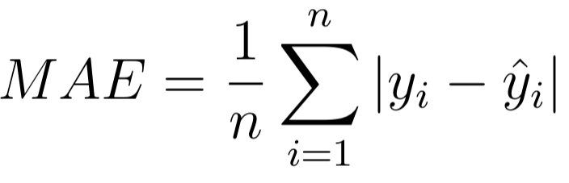
Additional Regression Metrics
Metrics
R2 score 1 -> -inf
Mean squared error 0 -> inf
Mean absolute error 0 -> inf
Notes:
Photo: https://www.flickr.com/photos/107442568@N08/12547327134

Slide 5
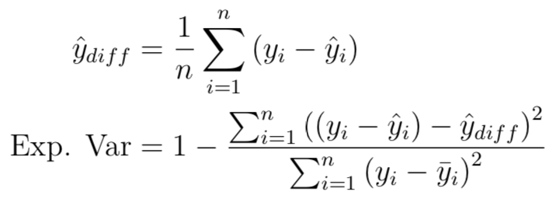
Additional Regression Metrics
Metrics
R2 score 1 -> -inf
Mean squared error 0 -> inf
Mean absolute error 0 -> inf
Explained variance score 1 -> -inf
Notes:
Photo: https://www.flickr.com/photos/107442568@N08/12547327134

